Slide 1
Lab Assignment # 4 Articles with Notes
PSY 15
Mandy Small
February 17, 2021

Slide 2
Instructions
Using the 4 peer-reviewed articles (other than the main article you submitted in Assignment #3), read and take notes on each of the four supplemental articles. Submit your notes. You will be graded on the relevancy of the article to your topic and for the thoroughness of your notes.
Notes should include the following:
Article reference information in correct APA format
Major results and key findings
Any quotes, methods, or other information that you may wish to use
Assignment #4 is worth 20 points

Slide 3
Example
My research question (stated clearly)
Research question: What type of recess activity and environment best helps elementary school students in school (academic and behavioral)?
Berman, M. G., Jonides, J., & Kaplan, S. (2008). The cognitive benefits of interacting with nature. Psychological Science, 19, 1207-1212. http://dx.doi.org/10.1111/j.1467-9280.2008.02225.x
Major results and key findings:
Digit span performance improved after walk (nature) compared to walk (urban), mood improved too but was no correlated with performance. Nature walks reported to be more refreshing on direct but not involuntary memory.
Other information:
“To consider the availability of nature as merely an amenity fails to recognized the vital importance of nature in effective cognitive functioning.” Page 1121.
Study 1: to determine how interactions with nature and urban environments affect cognitive performance.
Study 2: (to test ART) to determine if interactions with nature improve only executive attention (directed) and not alerting or orienting (which require less cognitive control).
APA Reference
Brief results, including condition info as it relates to my research question
I really like this quote, I may want use it. I want to remember that this article had 2 studies with different outcomes

Slide 4
Formatting and Due Date
Type this assignment
12 point, Times New Roman font.
Use APA formatting for the reference.
Include your name and section number.
Submit your work to CatCourses by 11:59 PM on February 24th, Wednesday (no late work will be accepted).
Pdf format only

Slide 5
Pieces of a TYPICAL ARTICLE
Title: Topic and information about the authors.
Abstract: Brief overview of the article.
Introduction: Background information and statement of the research hypothesis.
Methods: Details of how the study was conducted, procedures followed, instruments used and variables measured.
Results: All the data of the study along with figures, tables and/or graphs.
Discussion: The interpretation of the results and implications of the study.
References/Bibliography: Citations of sources from where the information was obtained.

Slide 6

Title: Topic and information about the authors.

Slide 7
Title: Topic and information about the authors.

Slide 8
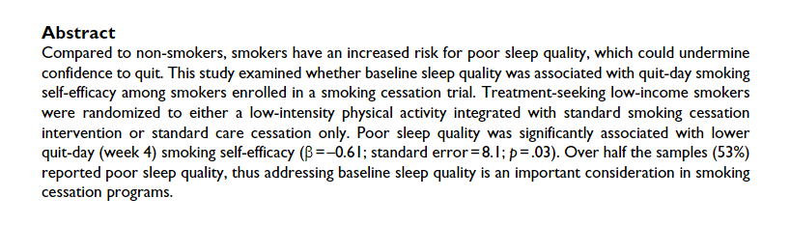
Abstract: Brief overview of the article.

Slide 9
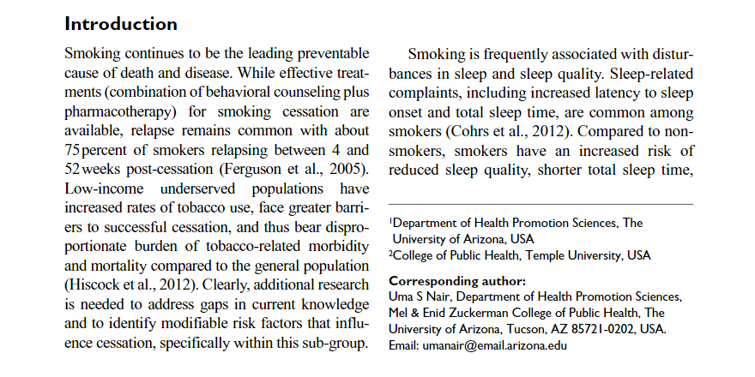
Introduction: Background information and statement of the research hypothesis.

Slide 10
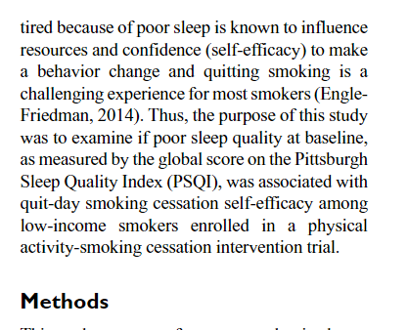
Hypothesis (in the Introduction)

Slide 11
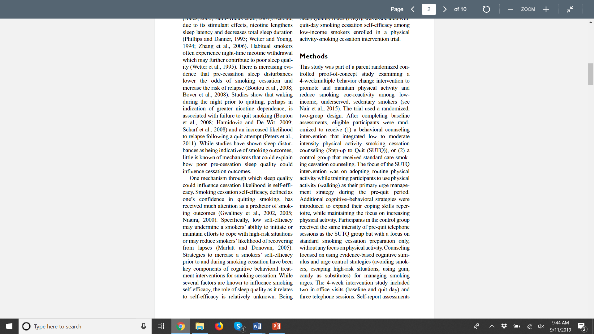
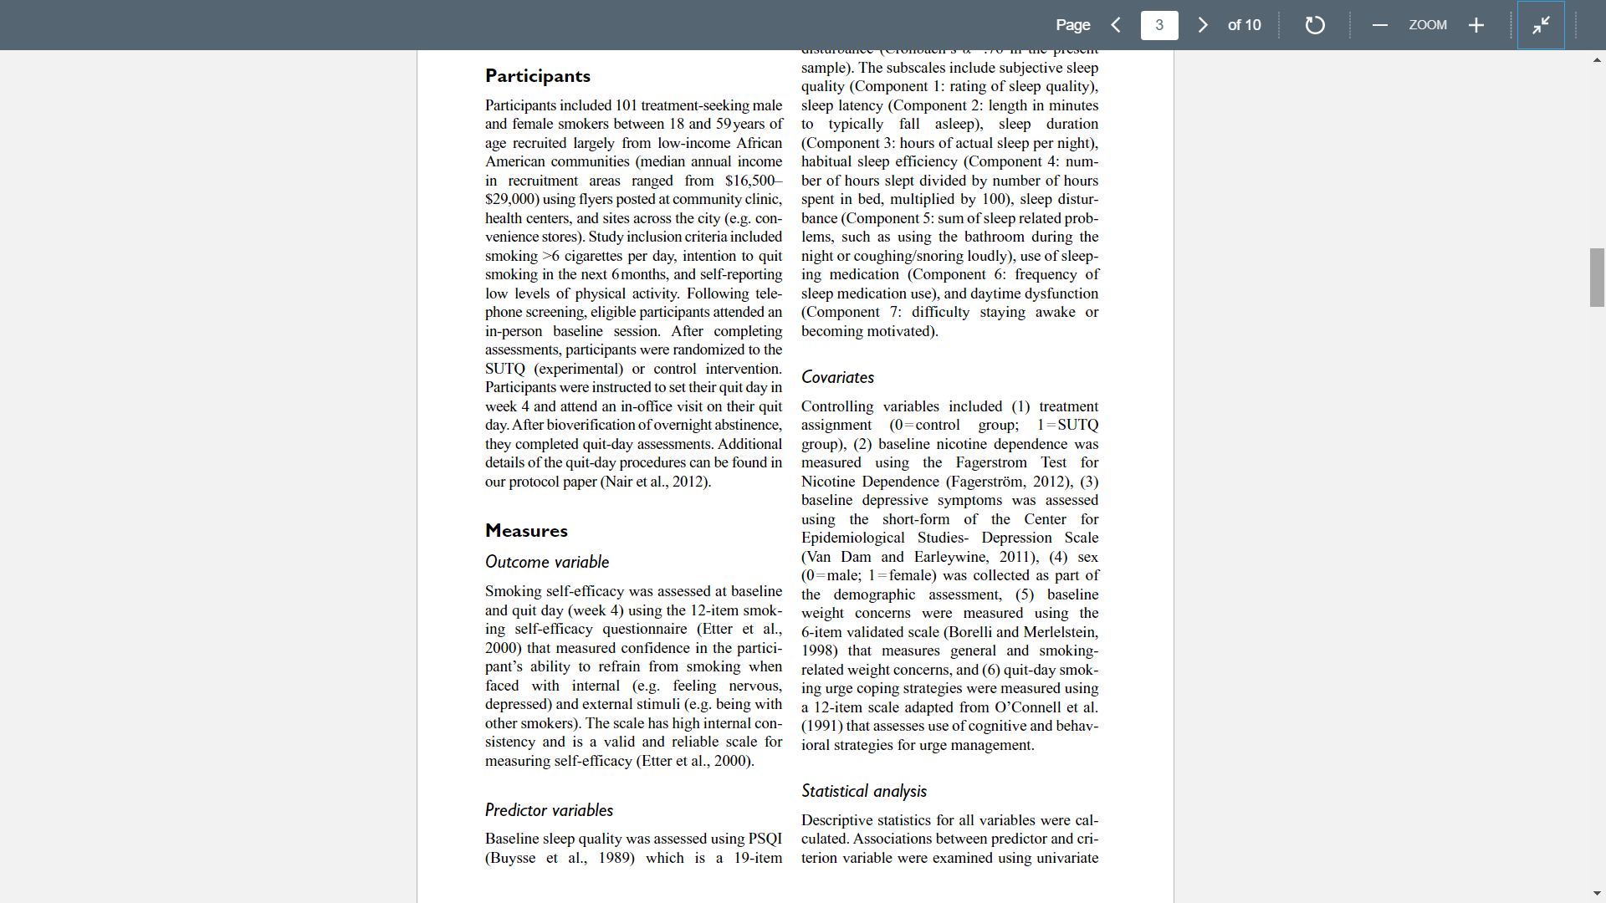
Methods: Details of how the study was conducted, procedures followed, instruments used and variables measured.

Slide 12
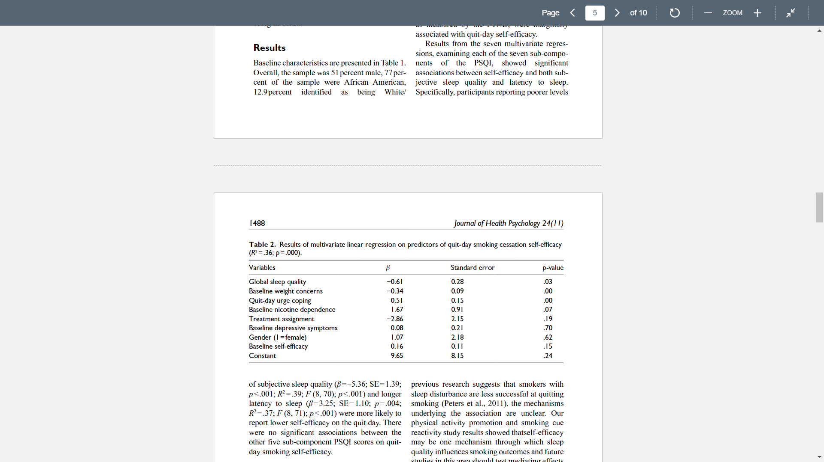
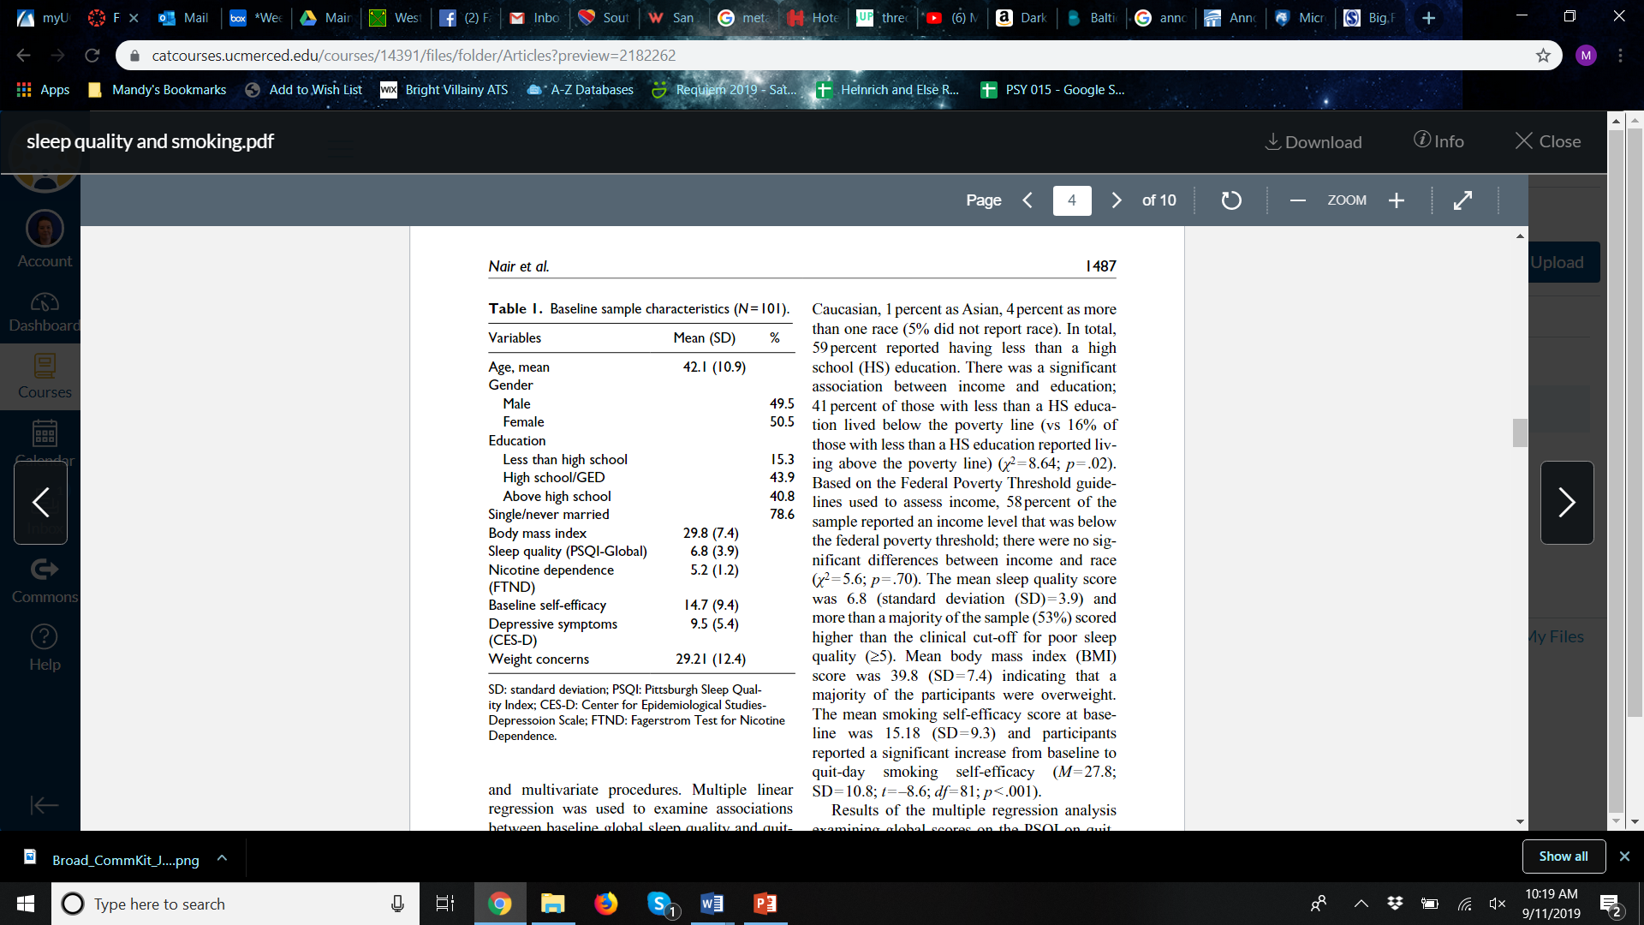
Results: All the data of the study along with figures, tables and/or graphs

Slide 13
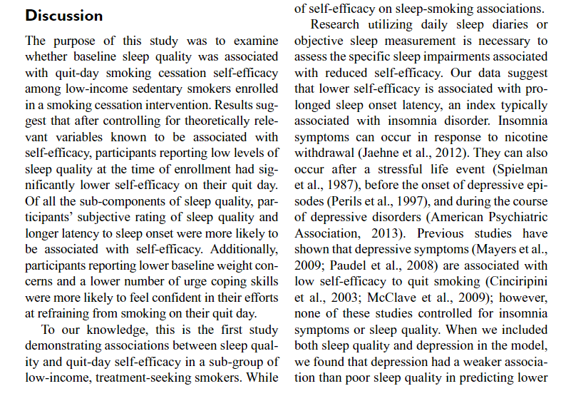
Discussion: The interpretation of the results and implications of the study.

Slide 14
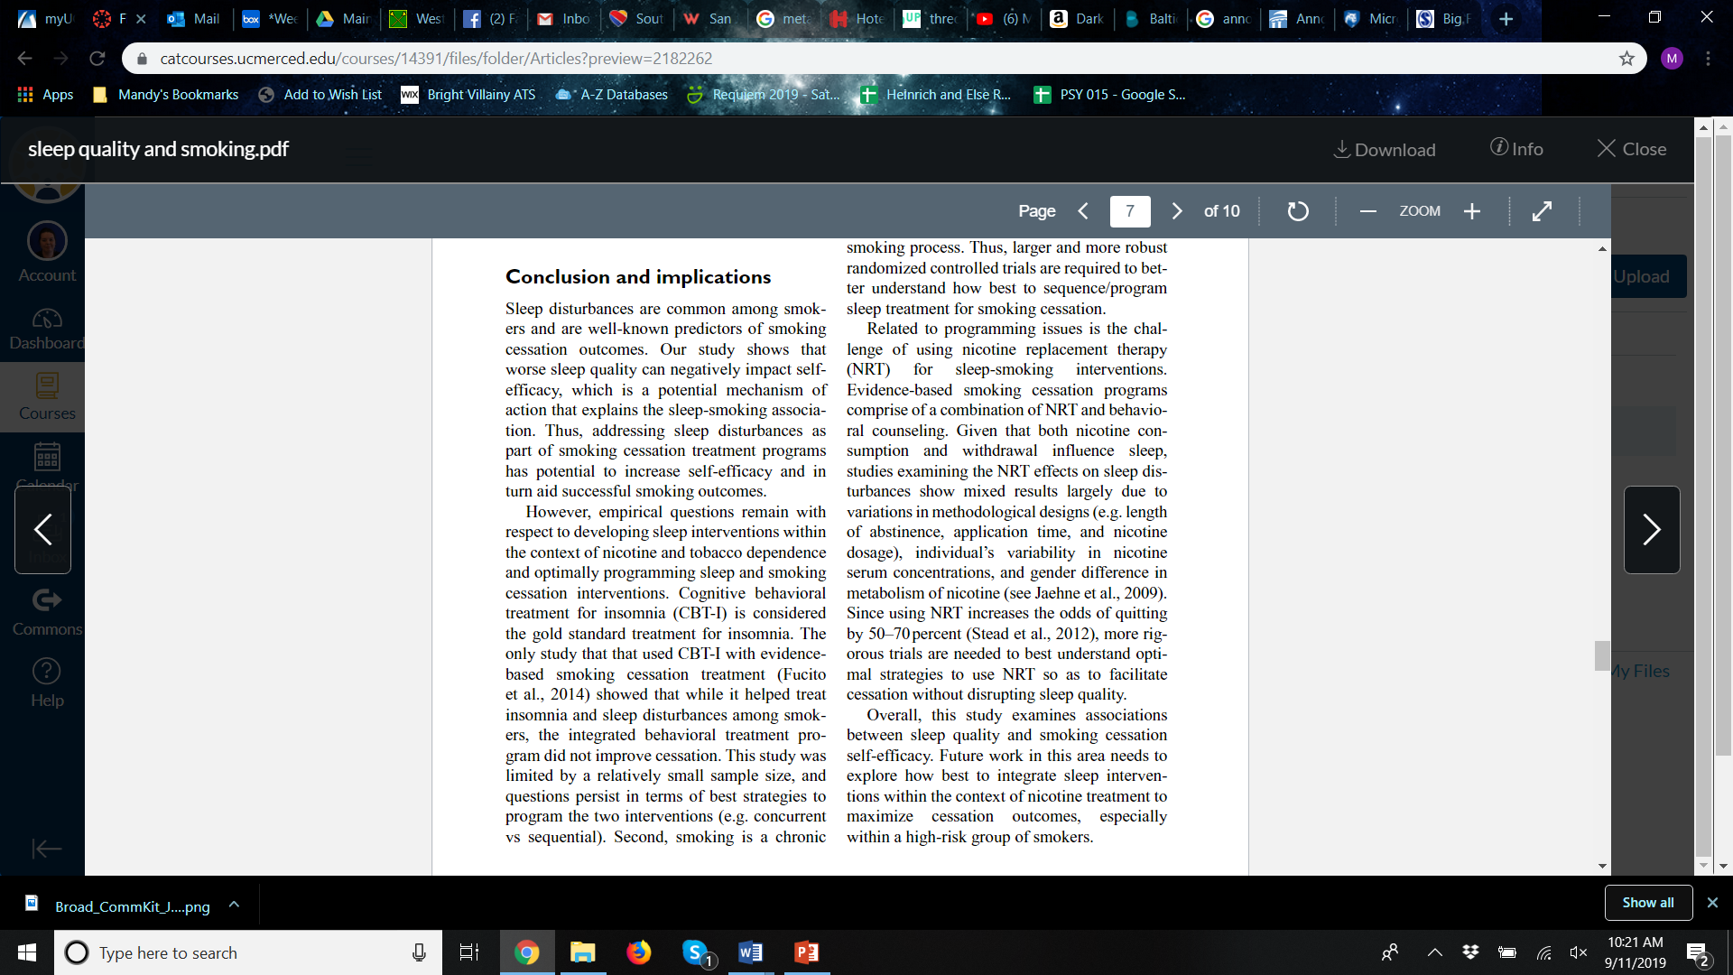
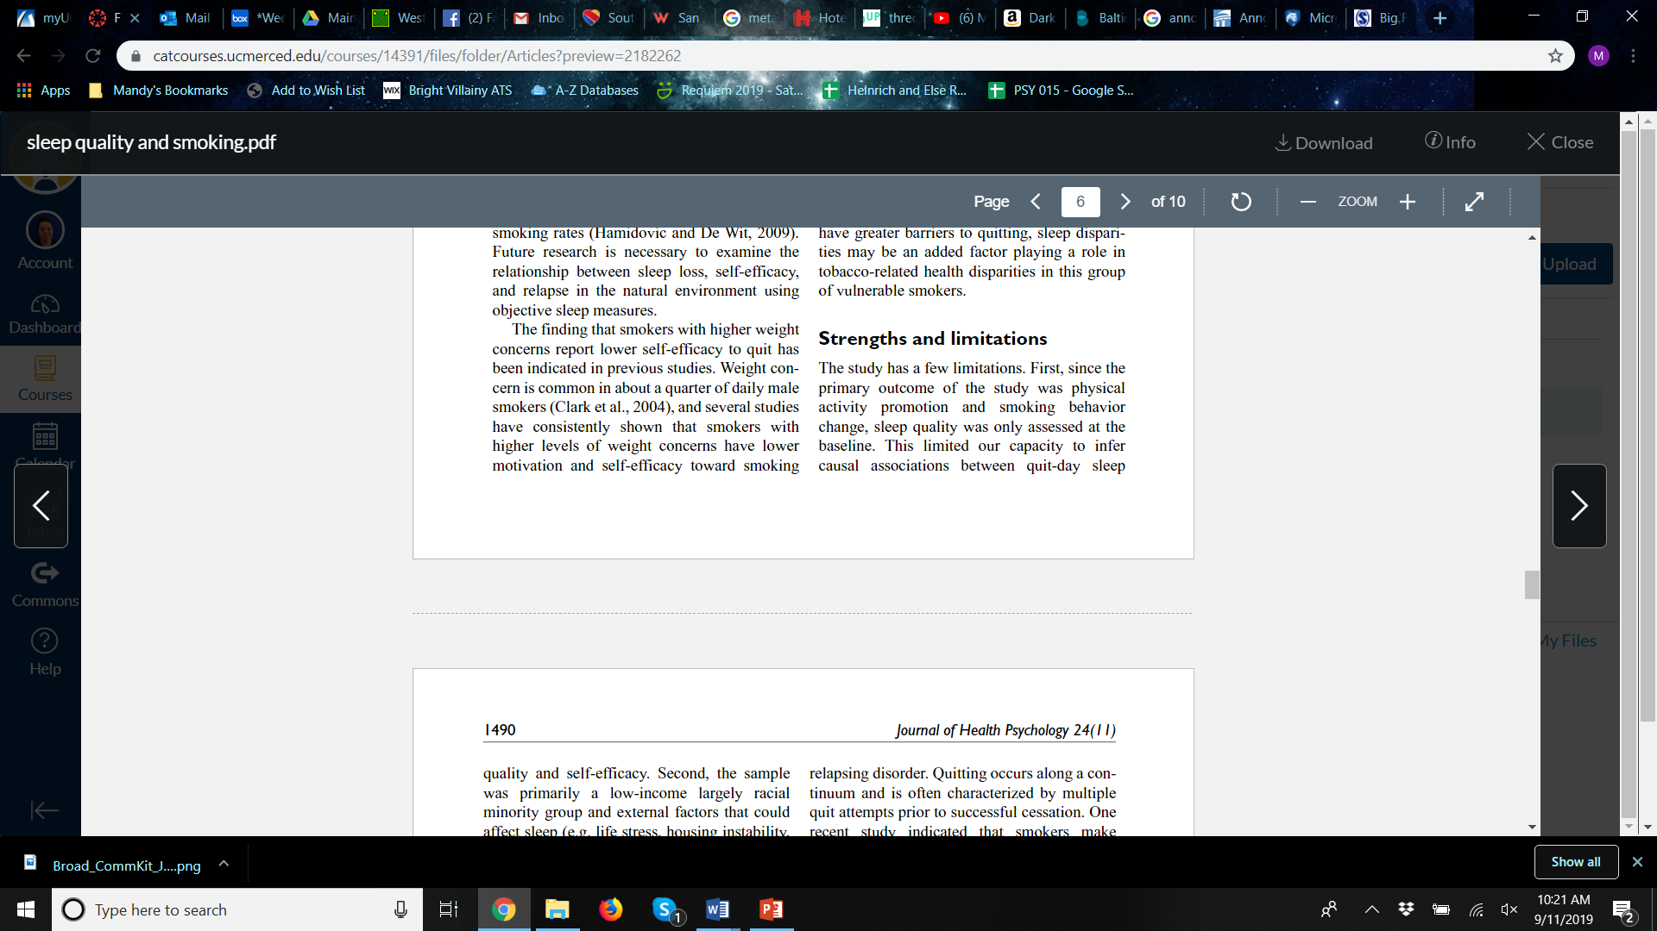
Limitations, Implications, Conclusions (in the Discussion)

Slide 15
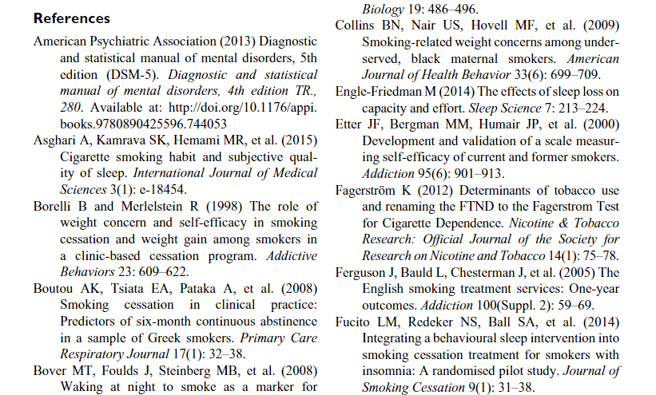
References/Bibliography: Citations of sources from where the information was obtained.

Slide 16
Alternate Reading Order
Authors
Title
Abstract
Figures/Tables
Methods
Introduction
Results
Discussion

Slide 17
Questions To GUIDE Your Reading
Introduction: What is the purpose of the article?
What specifically is the article is addressing?
Why is this an interesting or worthwhile topic/phenomenon to research?
What is already known about this topic/phenomenon?
Where are the gaps in contemporary knowledge or understanding of this topic/phenomenon?
What were the main independent variables (what the researchers manipulated) and dependent variables (what the researchers measured)?
Method: What research techniques are used by the author(s)?
Is this qualitative or quantitative research?
Results: What did the researchers find
How do the results relate to the predictions/hypotheses set out in the introduction (i.e., are they supported or not)?
Are the results reported and analyzed in an unbiased manner?
Discussion: How do the authors interpret the findings?
Do the authors discuss implications of their findings for theory, or for the "real world"?
What suggestions are being made about future research into this topic/phenomenon
What limitations does the study have?

